Slide 1

Property-Hub
Presentation by
Rani Chowdary Mandepudi
Bharadwaj B. Balaji
Sai Roopesh Mandava

Slide 2


PROBLEM STATEMENT
In the current real estate market, there is a lack of a centralized platform that efficiently connects property buyers and sellers.
This fragmentation leads to a time-consuming and often complex process for both parties, resulting in inefficiencies, delays, and a suboptimal user experience.
The need for a comprehensive solution that streamlines property transactions, enhances visibility, and fosters transparent communication is evident. Our project aims to address this gap by creating a fully functional website with three dedicated portals, bringing together buyers and sellers in a user-friendly and efficient manner.

Slide 3

Scrum
What is Scrum?
Scrum is a Framework that helps the people ,teams and organizations generate value through adaptive solutions for complex problems.
It's framework of rules, roles, events and artifacts used to implement Agile projects. It is an iterative approach, consisting of sprints that typically only last one to four weeks.

Slide 4


Scrum Events
All events are time-boxed.
Once a Sprint begins, its duration is fixed and cannot be shortened or lengthened. Scrum Events are:
Sprint
Sprint Planning Daily Scrum Sprint Review
Sprint Retrospective

Slide 5
Benefits of Scrum
Quicker release of the useable product to users and customers
Higher quality
Higher Productivity
Lower costs.
Greater ability to incorporate changes as they occur
Better user satisfaction

Slide 6


WHY SCRUM WORKS
With scrum, work is done by the development team simultaneously rather than sequentially. Programmers code on the fly and do not wait until all questions are answered, and everything is crystal clear before they start to program.
With scrum, there is adaptability. Changes can be supported and integrated into a project currently in progress.
With Scrum, tasks are prioritized by order of importance and this usually means that tasks to be completed first will probably affect the return on investment the most.

Slide 7
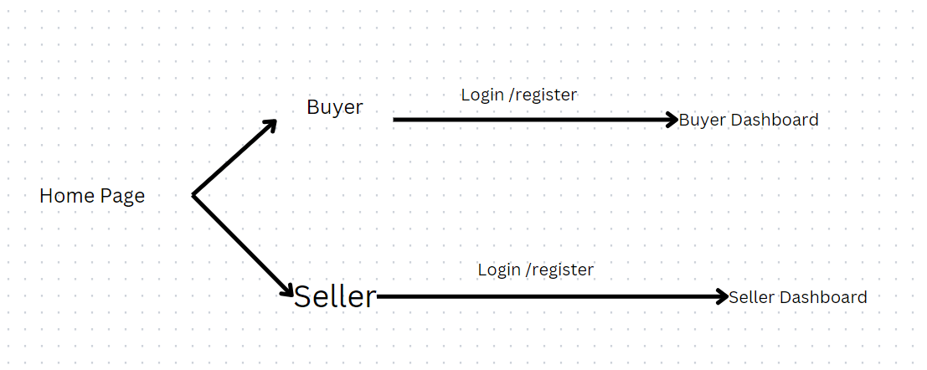
Flow Diagram

Slide 8
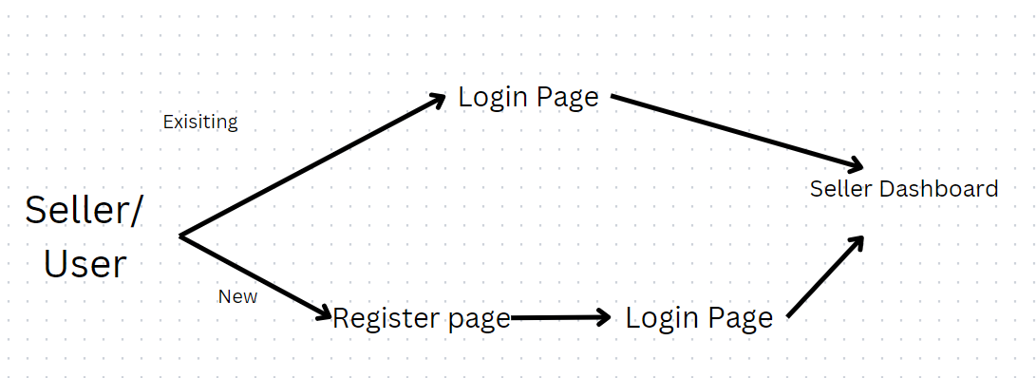
Seller Flow diagram

Slide 9
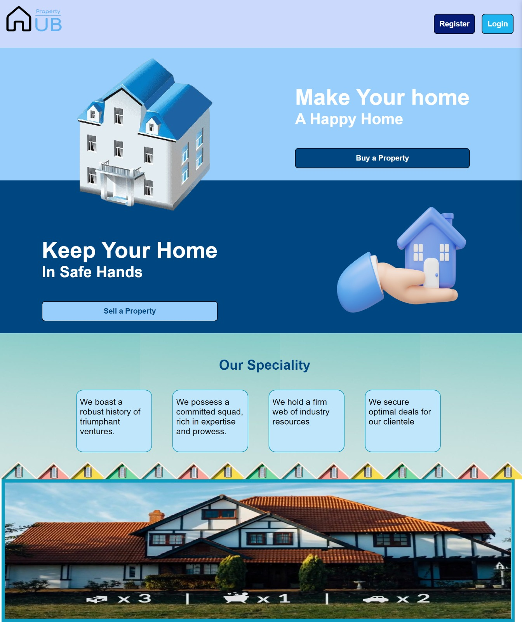
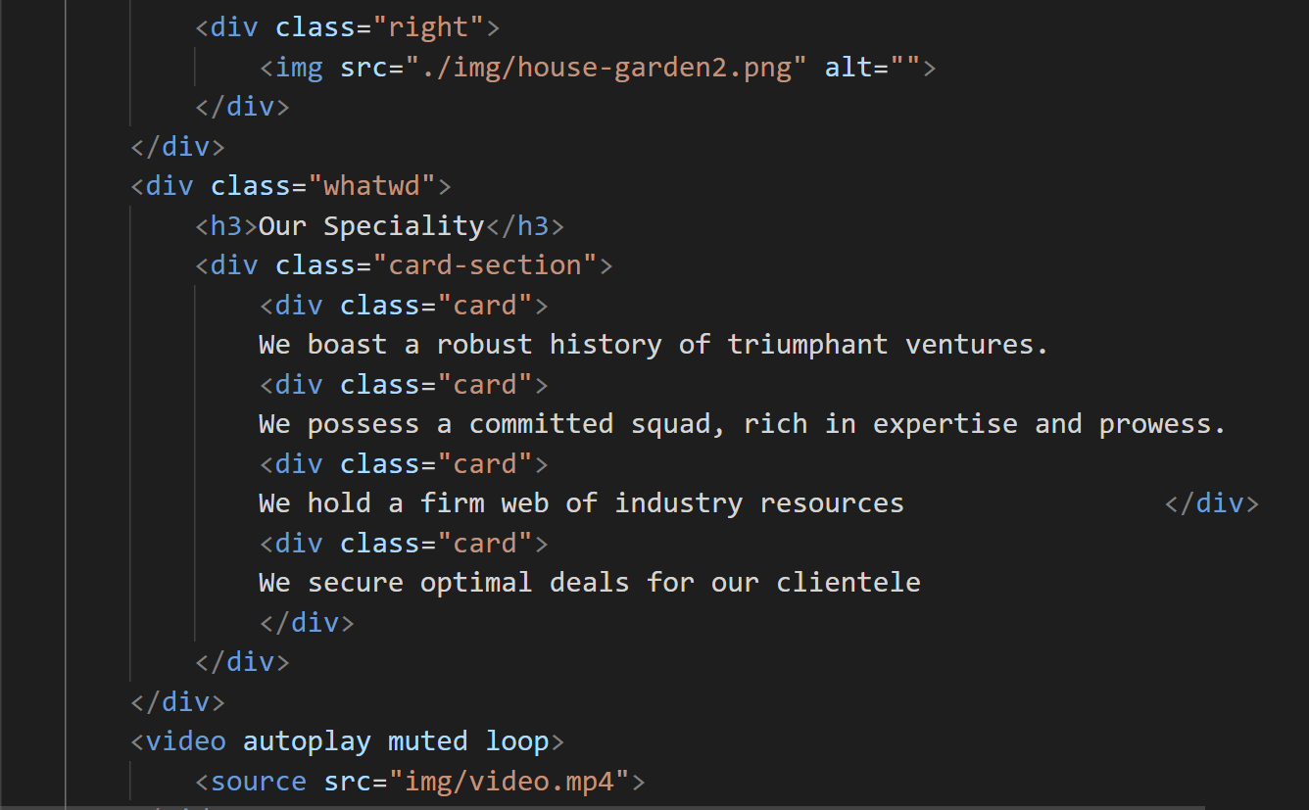
Homepage(index.php)
09

Slide 10
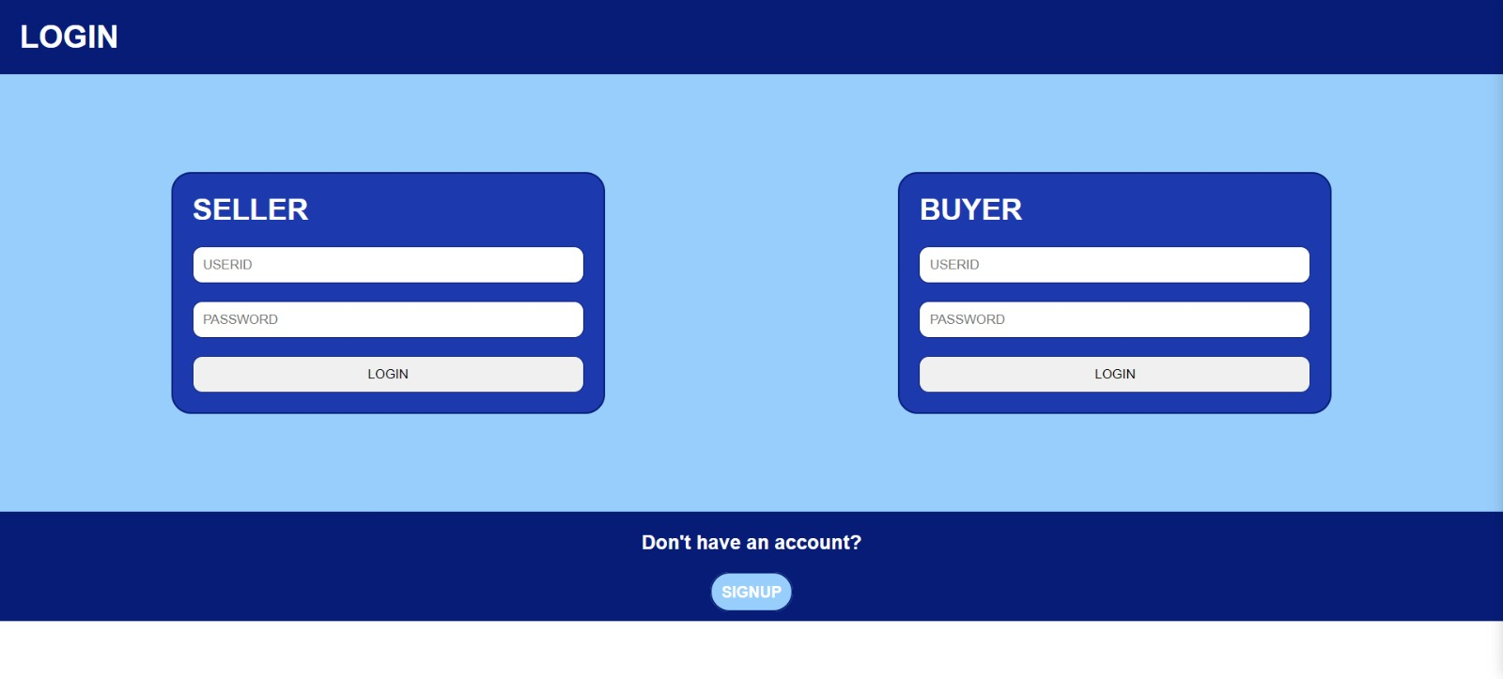
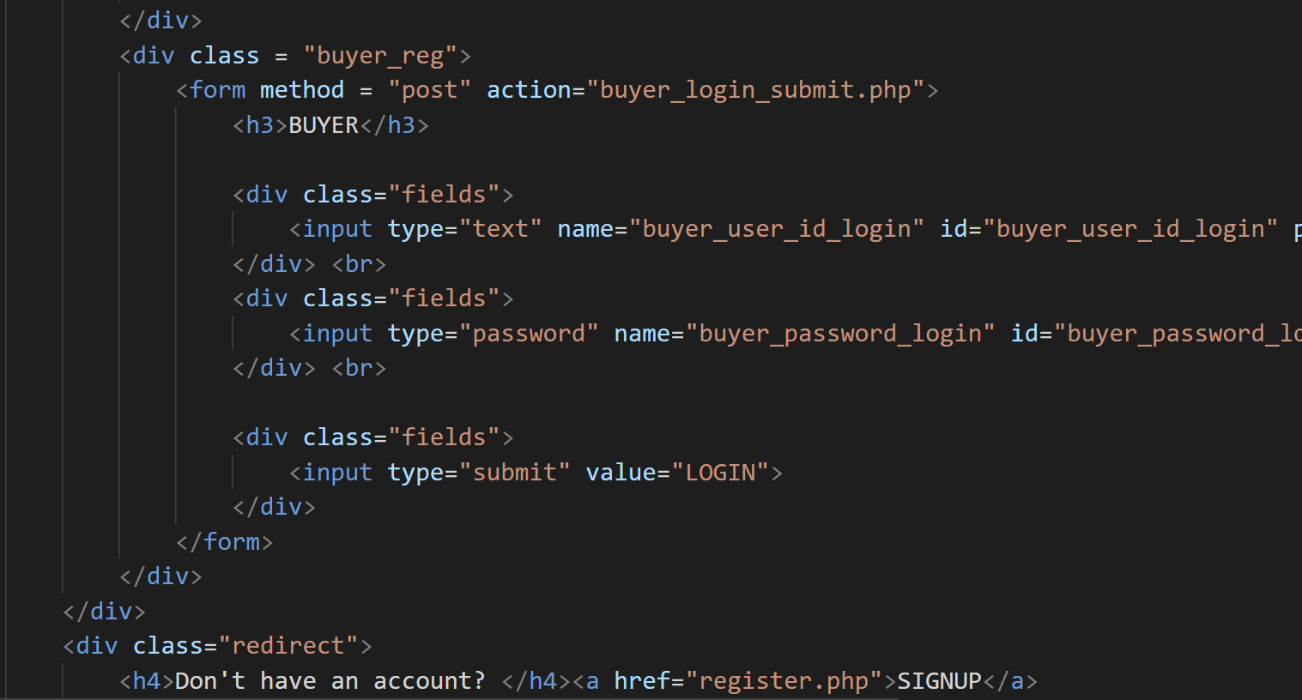
Login.php

Slide 11
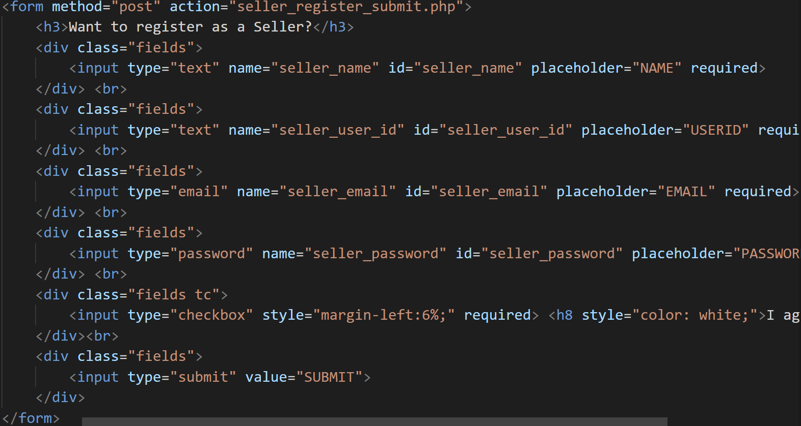
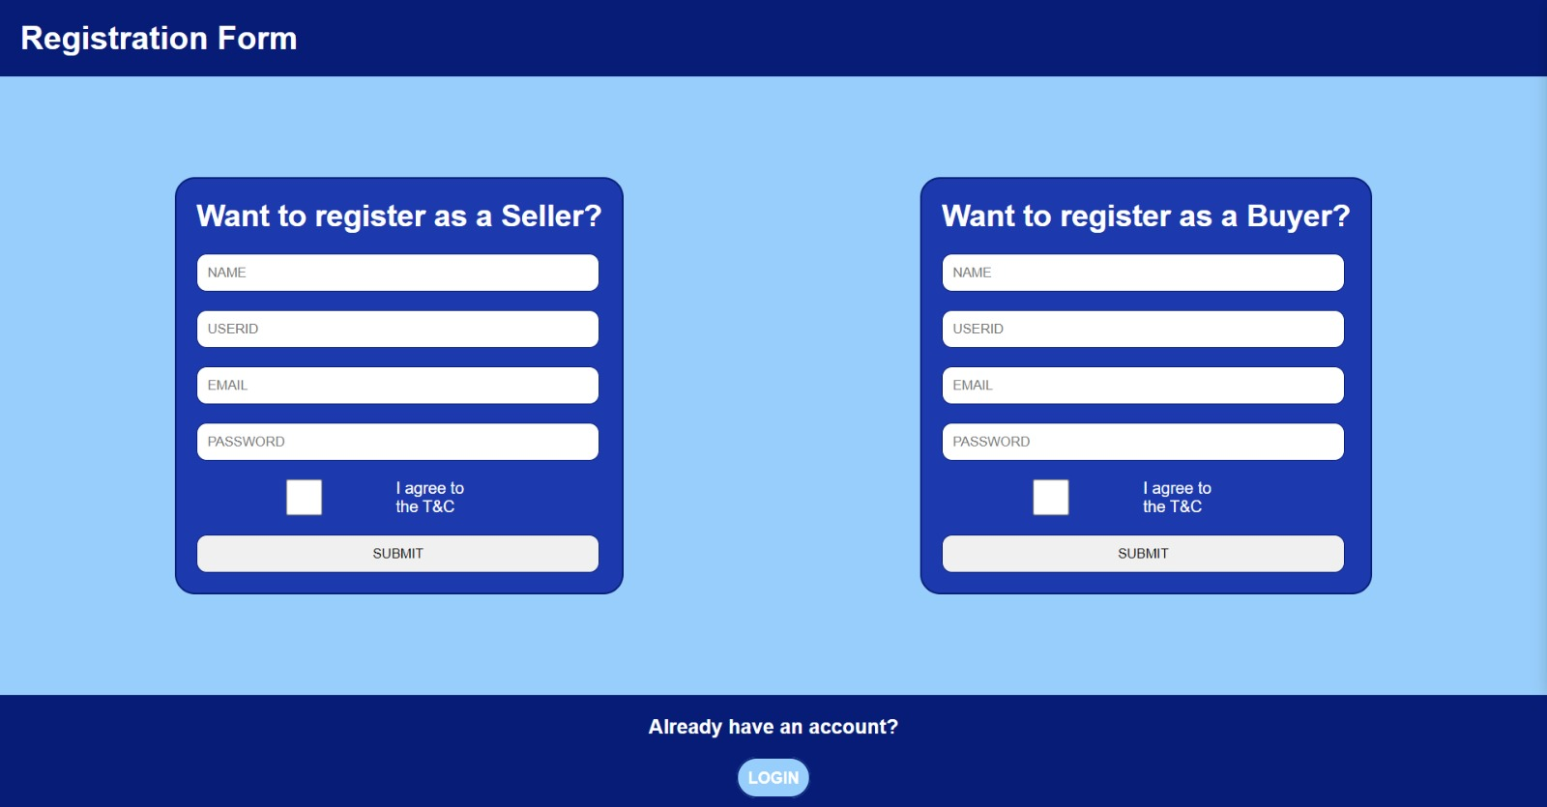


Register.php

Slide 12
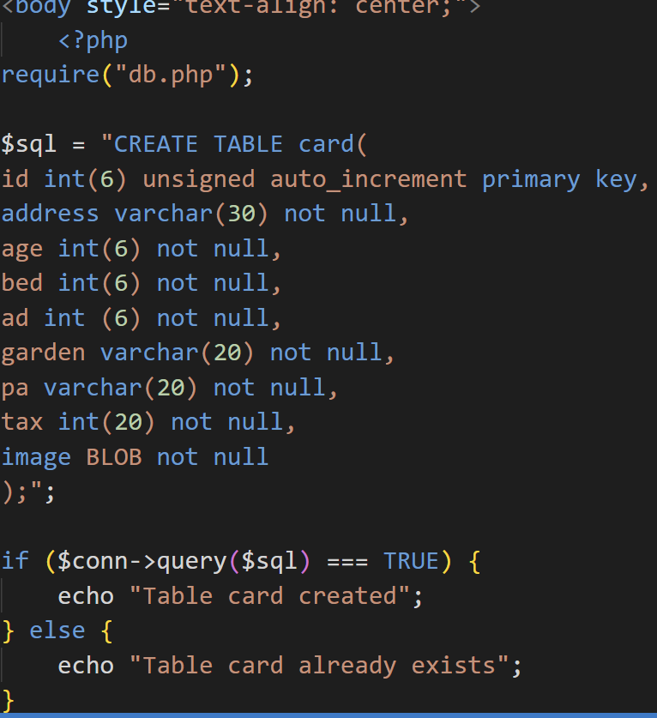
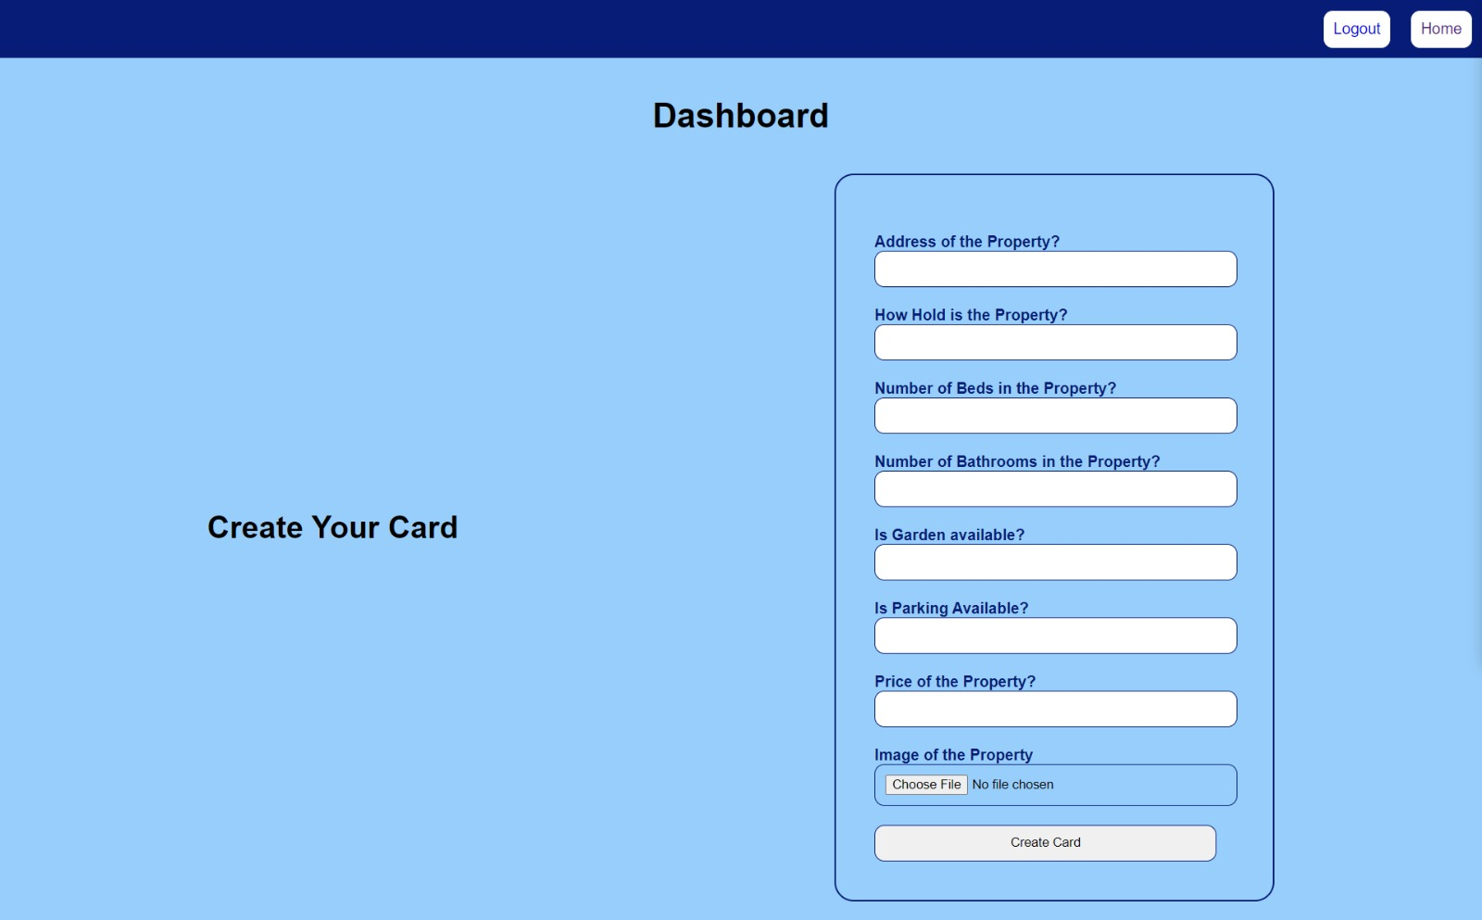
Create a Property Card

Slide 13
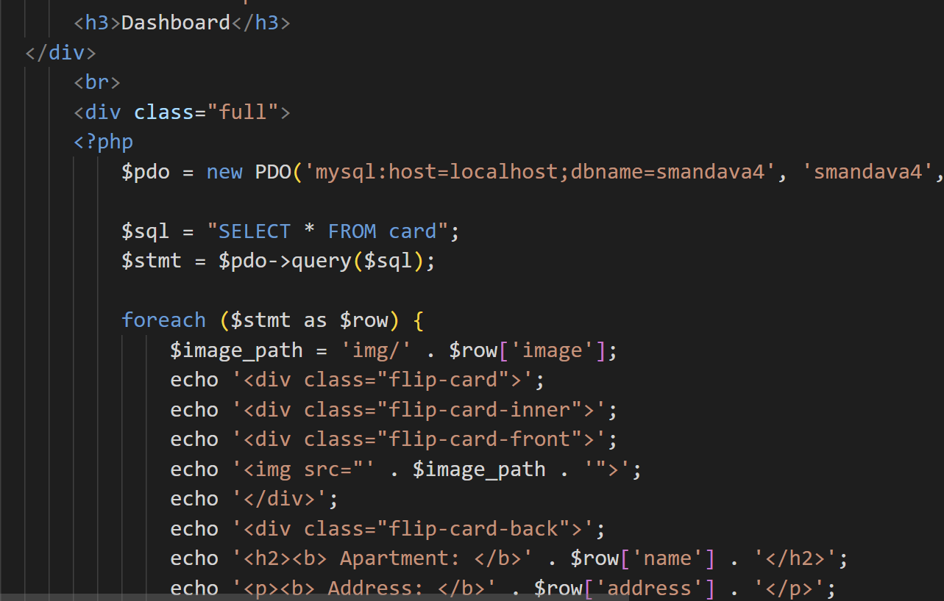
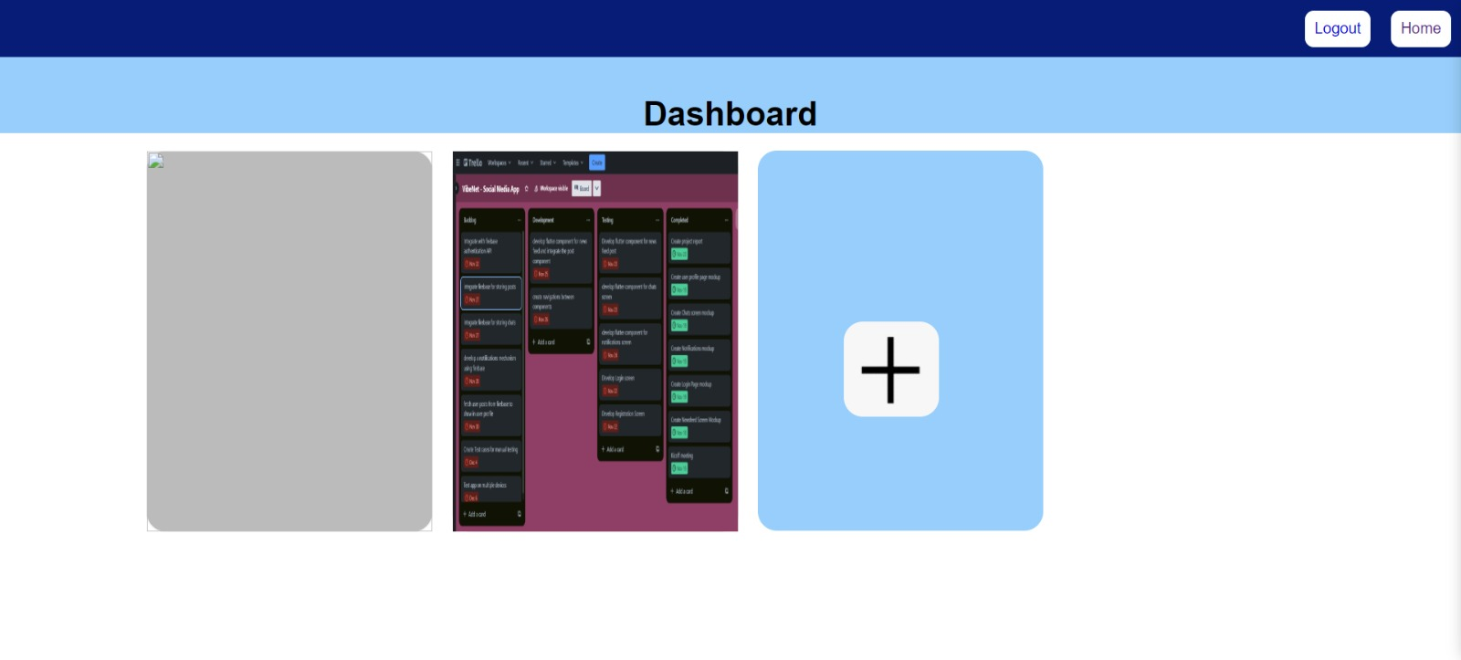
Seller Dashboard
10

Slide 14
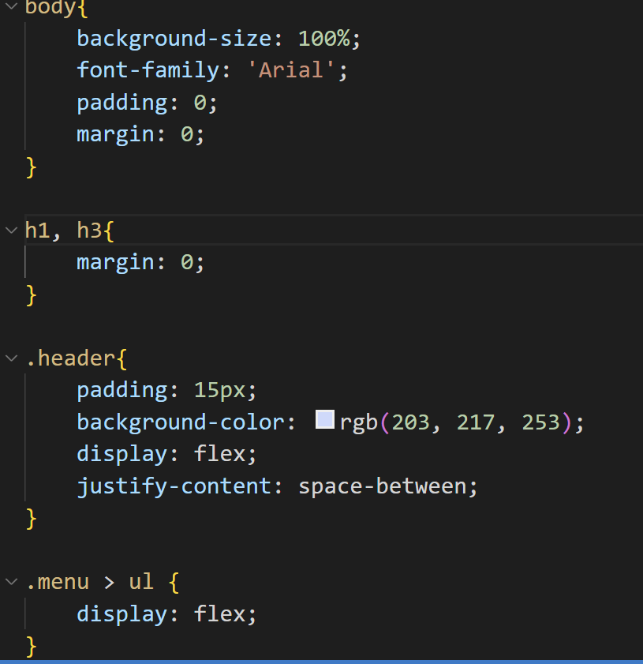
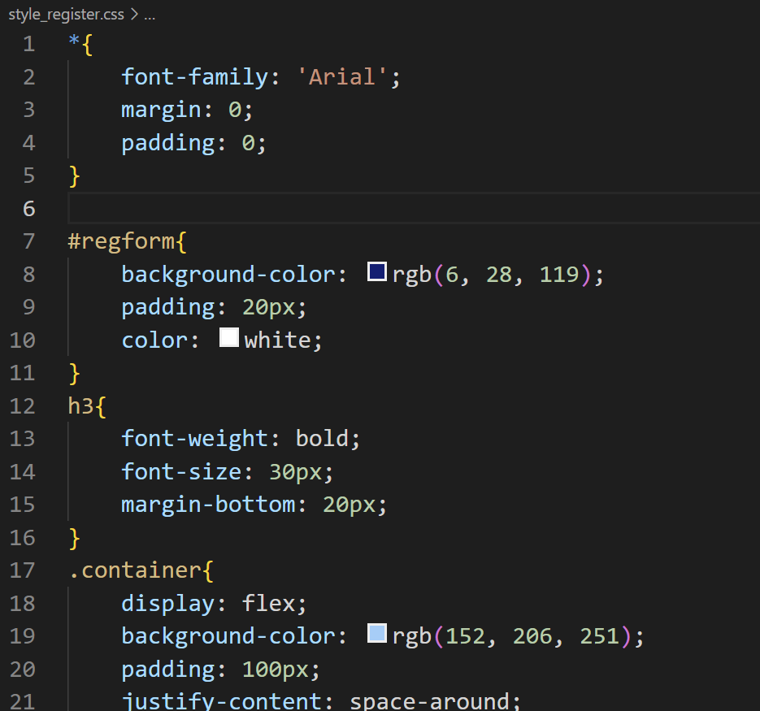
CSS Animation (Background)
05

Slide 15
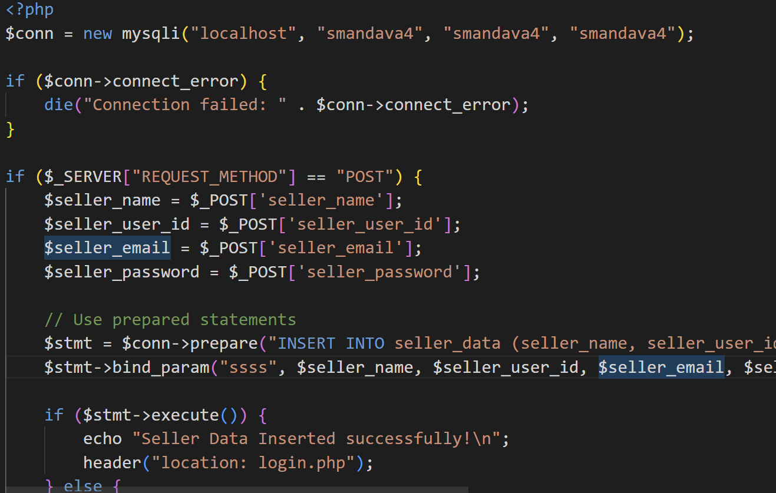
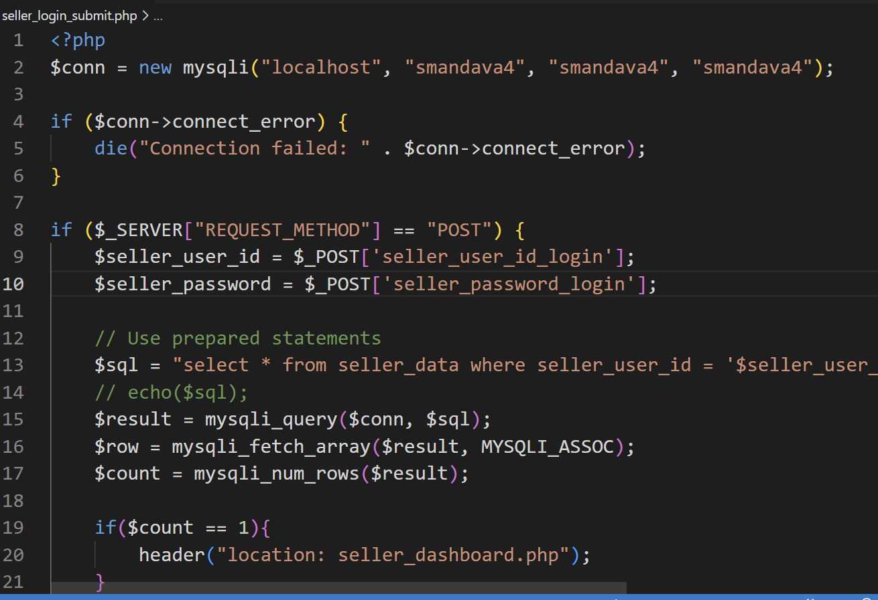
Db connect

Slide 16
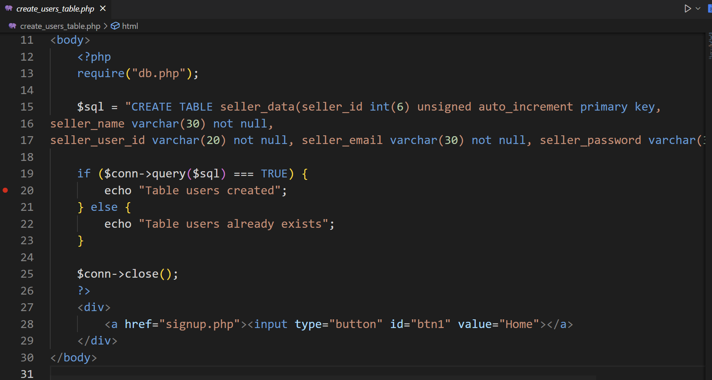
Create Table

Slide 17
Testing
Safari Chrome Firefox

